Slide 1
Analysis on Side Effects of Covid-19 Vaccination
Course - Data 225: Database Systems For Analysis

Slide 2






Vishnu Pendyala
ADVISOR
Nikita Balani
MSDA SJSU
Pravallika V
MSDA SJSU
Nirvisha G
MSDA SJSU
Jinu Mathew
MSDA SJSU
Vineeth C
MSDA SJSU

Slide 3
Overview
INTRODUCTION
MOTIVATION AND LITERATURE
DESIGN TOOLS
DATABASE DEVELOPMENT - Conceptual Design
DATABASE DEVELOPMENT -Logical Design
AWS IMPLEMENTATION
CODE ANALYSIS
DATA VISUALIZATION
TECHNICAL DIFFICULTIES
LESSONS LEARNED
Q/A

Slide 4
Introduction
The dataset for the project is taken from VAERS(Vaccine Adverse Event Reporting System).
VAERS is co-managed by CDC and FDA.
The dataset includes patients information who got side effects from covid-19 vaccination from 1st january to 8th april.
3 covid-19 vaccines which was approved by us government are Pfizer/Biotech, Moderna, Johnson and Johnson.
80-90 % cases are mild symptoms but the rest 10-20% includes critical situations like hospitalization, life-threatening injury or death.

Slide 5
Motivation and Literature
With the whole pandemic situation going on around the world, the covid-19 vaccine was developed faster than usual pace.
In usa vaccine distribution started in january for the mass population, within a month VAERS had the data of n number of people who got any side effect from covid vaccine.
Coming across the VAERS website through kaggle, we thought of analysing the data will help understand the effectiveness of different vaccines.
Our analysis will also help in future distribution of covid-19 vaccine and helps predict the effectiveness of different vaccine brands.

Slide 6



















Design Tools

Slide 7
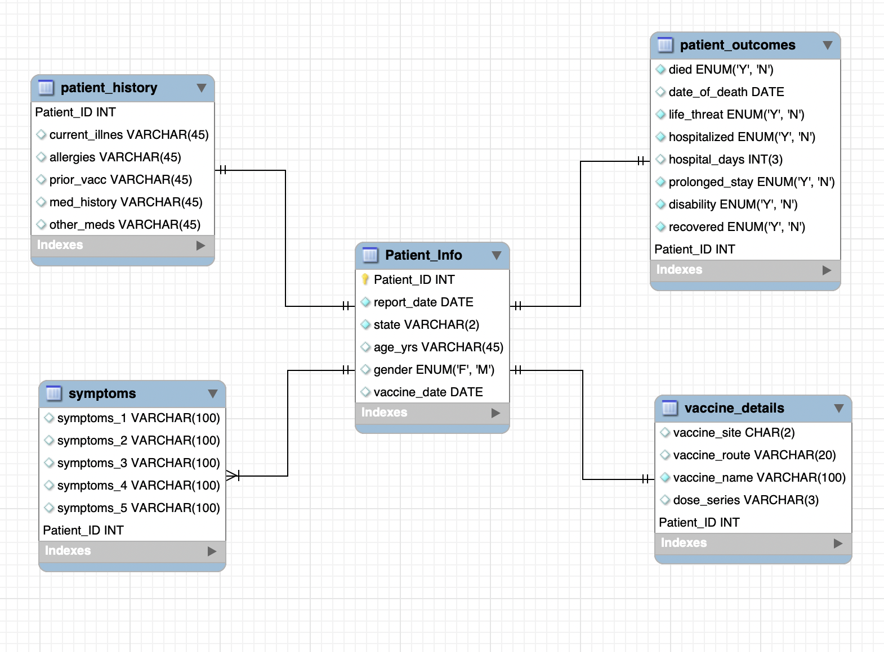
Database Development -Conceptual Design
Conceptual Schema
Here from our dataset we modeled our data into 5 tables and below is our Conceptual model for the Data,Here we modeled our data using Mysql Workbench and established relationships between the tables.

Slide 8
Database Development -Logical Design
Coming to Logical design We created tables according to the data we modeled and then established primary key-Foreign key between them and below are the table names patient_Info,patient_history,patient_outcomes,symptoms,Vaccine_Details.
We created a trigger for our Vaccine details Table where if the vaccine name is other than Pfizer, Moderna, Janssen then it will return us message that ‘This is NOT A COVID VACCINE’.

Slide 9
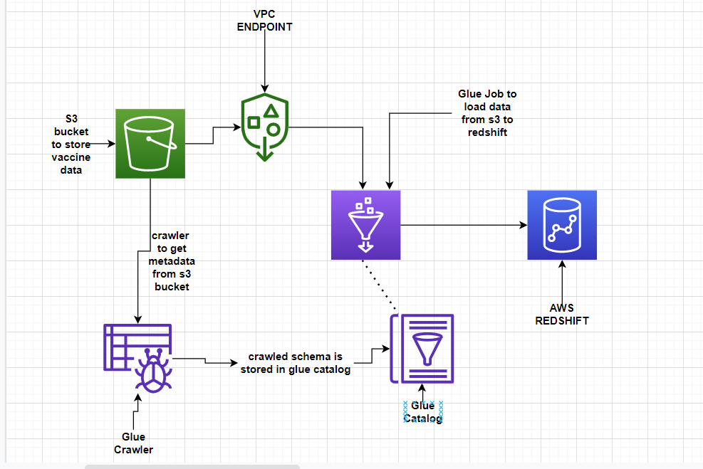
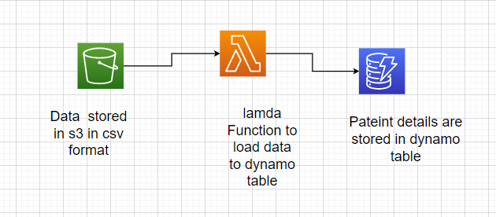
AWS Implementation
In AWS, we loaded the data into s3 buckets and then created a VPC Endpoint and from s3 we moved the data to crawler which is stored in Glue Catalog and then used to Glue job to load the data from S3 to Redshift and then used nosql database Dynamodb for table creation of one table and then loaded the data from s3 to dynamodb table using Lambda functions .

Slide 10
Code Analysis
Code analysis was done by the teammates who did not written that code before implementing the code.
For PostgreSQL, the queries were analysed before performing
We also analysed and edited the pySpark script generated by AWS Glue to load the tables into Amazon Redshift.
Python pandas code was analyzed during implementation for all possible errors or exceptions.

Slide 11
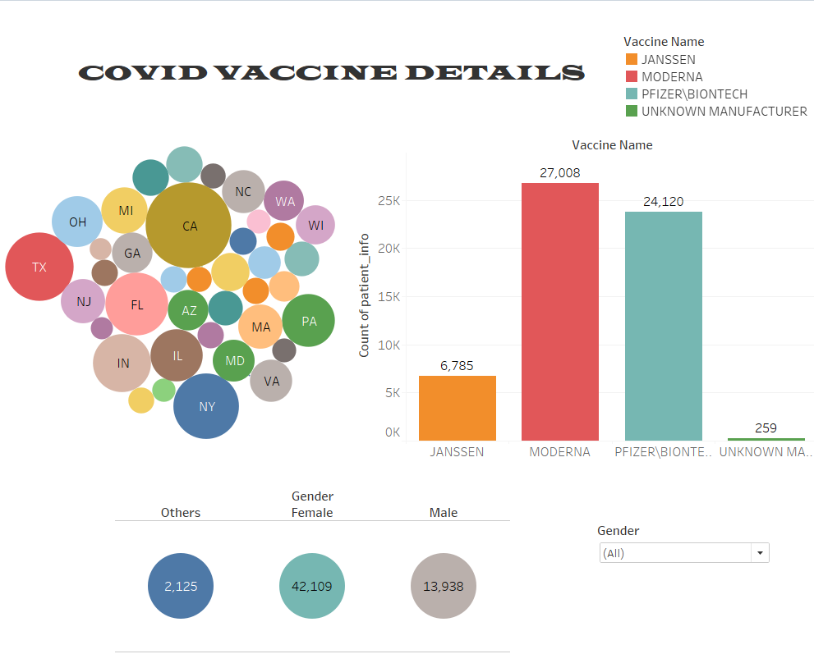
Data Visualization
By placing data in a graphic way, such as charts or graphs, data visualization helps us understand what it entails. This makes the data more natural to understand for the human eye, making it possible to spot trends, patterns, and outliers in vast data sets.we used Tableau and python seaborn library for visualizing.

Slide 12
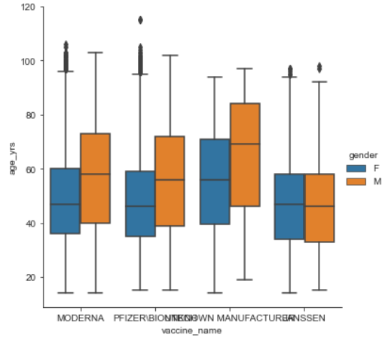
Analysis with visuals

Slide 13
Technical Difficulties
Difficulty loading data into Postgres tables. Resolved that by creating appropriate data model and data cleaning.
We had difficulty while connecting tableau with PostgreSQL(pgAdmin). It was server error which was resolved eventually.
While making connections from s3 to glue to redshift we faced issues with endpoints, which was then resolved by creating VPC endpoints.
We had file encoding issues while loading the data into PostgreSQL, our data had iso-8859-1 encoding while our database had utf8 encoding. So we changed our csv files encoding using Excel.

Slide 14
Lesson Learned
Designing the tables (Data Modelling) should be done in the early stage of the project.
Before loading the data, the csv files should include cleaned data only otherwise it becomes tedious task to clean and load at every step after an error is thrown by database.
Data cleaning with cloud ETL tool like AWS glue is much easier than python pandas.

Slide 15
Conclusion
In Conclusion, the analysis done in this project for covid-19 vaccines’ side effect can be helpful in predicting future casualties because of the same vaccines. Also, which vaccine is better can be determined by the analysis. It also sets the goal for future manufacturers for the different disease vaccine.

Slide 16
Thank You

Slide 17
Question & Answer

